Slide 1
Residential Segregation in Integration Area:
The Evaluate of Integration Area With Respect to Ethicality and Social Class
About the research
Many European governments have been working hard to create the “mixed communities”, as the integrated community is considered a promising approach to the population placement. However, the implementation of the integration strategy in respect of ethnicity or socio-economic groups is worth being contemplated .
This study assess the current status of residential isolation in Bradford from these two aspects to figure out their impact on residential segregation. In which, the race is divided into British whites and other races; the social class is differentiated by income.
Key findings
● The index of dissimilarity shows that the residential segregation between British white and other ethnic group in the Bradford has reached 66% which is almost twice as high as that between high-income and low-income groups(only 37.3%)
● The hotspot map of British white residential distribution presents that their aggregations are mainly in the north and southwest of Bradford, while a low-value cluster, in other words, an area with low white rate taking up a large area is located in the southeast.
● The distribution pattern of high-income groups is quite similar to that of British white. But its low-value clusters in the southeast are not connected that closely .

Slide 2
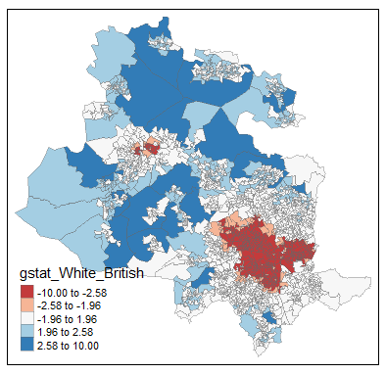
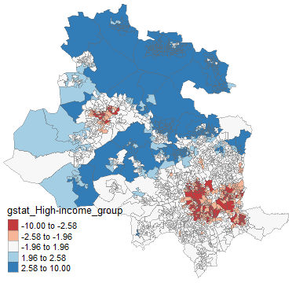
The hotspot map of British white
The hotspot map of high-income group
Conclusion
● The ubiquity of Residential segregation in Bradford not only reflected in the ethnicity but also in the socio-economic groups.
● Although the difference between the two hotspot map is not so clear, the discrepancy between dissimilarity indexes of ethnicity and socio-economic groups is large enough to determine the ethnicity as the main impact of the residential segregation.
More information
● Both racial and job statistical are census data published by NSSEC.
● The aim of comparison between British white and other races is making full use of the data. In that case, the haphazard can be minimized as possible.
● Taking OA instead of ward as the spatial scale is considering the accuracy of the aggregation. As spatial scale decrease, the distribution pattern will be closer to the real one.
Key resources
Moos, M. (2016) ‘From gentrification to youthification? The increasing importance of young age in delineating high-density living’, Urban Studies, 53(14), pp. 2903–2920. doi: 10.1177/0042098015603292.

